Slide 1
Capstone Project
Rossman Sales Prediction (Regression)
By – Mr. Pritam Gangwar & Mr. Piyush Mishra

Slide 2
Data summary
Problem statement
Objective
Data inspection
Data Analysis and visualization
Data Cleaning
Conclusion
Recommendations
Contents-

Slide 3
Data Summary
There are 2 data set all their column name and description is mentioned below.
Store - A unique Id for each store.
Sales - The turnover for any given day.
Customers - The number of customers on a given day
Open - An indicator for whether the store was open: 0 = closed, 1 = open
StateHoliday - Indicates a state holiday. Normally all stores, with few exceptions, are closed on state holidays. Note that all schools are closed on public holidays and weekends. a = public holiday, b = Easter holiday, c = Christmas, 0 = None
SchoolHoliday - Indicates if the (Store, Date) was affected by the closure of public schools
StoreType - Differentiates between 4 different store models: a, b, c, d
Assortment - Describes an assortment level: a = basic, b = extra, c = extended.
CompetitionDistance - Distance in meters to the nearest competitor store
CompetitionOpenSince[Month/Year] - gives the approximate year and month of the time the nearest competitor was opened

Slide 4
Data summary continued-
Promo - indicates whether a store is running a promo on that day
Promo2 - Promo2 is a continuing and consecutive promotion for some stores: 0 = store is not participating, 1 = store is participating
Promo2Since[Year/Week] - describes the year and calendar week when the store started participating in Promo2
PromoInterval - describes the consecutive intervals Promo2 is started, naming the months the promotion is started anew. E.g. "Feb,May,Aug,Nov" means each round starts in February, May, August, November of any given year for that store.

Slide 5
Problem Statement-
Rossmann operates over 3,000 drug stores in 7 European countries. Currently, Rossmann store managers are tasked with predicting their daily sales for up to six weeks in advance. Store sales are influenced by many factors, including promotions, competition, school and state holidays, seasonality, and locality. With thousands of individual managers predicting sales based on their unique circumstances, the accuracy of results can be quite varied.
We are provided with historical sales data for 1,115 Rossmann stores. The task is to forecast the "Sales" column for the test set. Note that some stores in the dataset were temporarily closed for refurbishment.

Slide 6

Objective-
The objective of the project is to create a machine learning model in regression to predict the sales of the company.

Slide 7

Data inspection-
In order to understand the data we need to look at the data frame and understand its meaning to provide a proper conclusion.
There are 2 sets of data after merging both the data frames on the column stores, there are 1017209 rows and 18 columns. The target column is “Sales”.
The dataset consist of 5 object , 8 integer and 5 float columns. We need to convert the object to either integer or float.

Slide 8
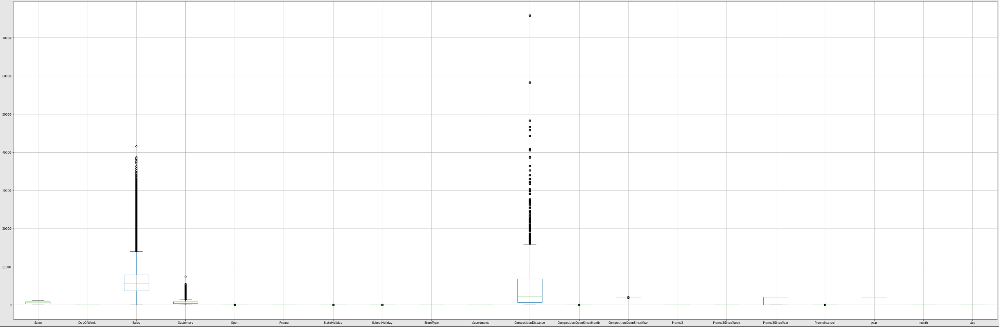
Boxplot representation of outliers-
Observation- “Sales”, “Customers” and “CompetationDistance” has outliers we are not removing them as all the three columns have possibilities to perform different from the average results.

Slide 9
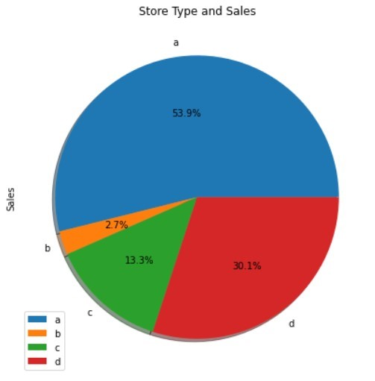
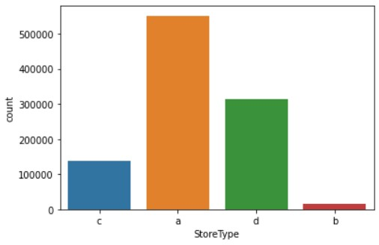
Relation between store type and their count-
Relationship between Store Type and Sales-
Observation- There are maximum numbers of store “a” with 551627 stores followed by “d”, “c” and “b” with 312912, 136840 and 15830 stores respectively.
Sales and number of stores are corelated, more the number of stores more will be the sales. Store ‘a’ has maximum percentage of sales with 53.9%, followed by ‘d’ , ‘c’ and ‘b’.

Slide 10
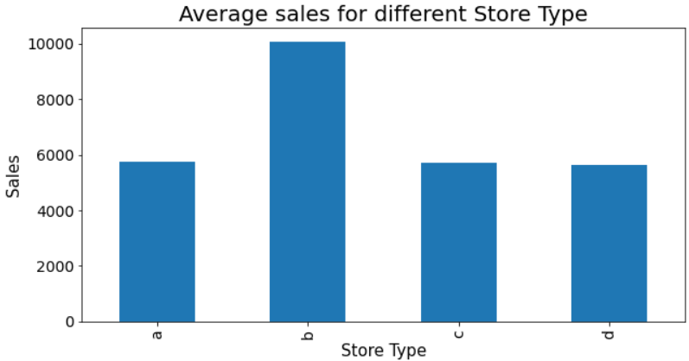
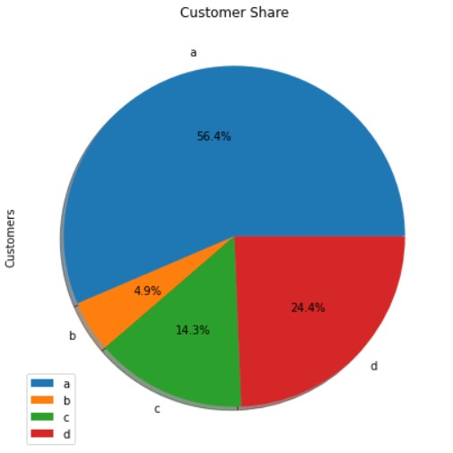
Average sales for different stores-
Customer share for different stores-
Observation- Although the store ‘b’ has least number of stores and sales, its average sales is better than other stores. This shows it is performing better than other stores.
Store ‘a’ has maximum number of customer share i.e. 56.4% followed by ‘d’, ‘c’, and ‘b’.

Slide 11
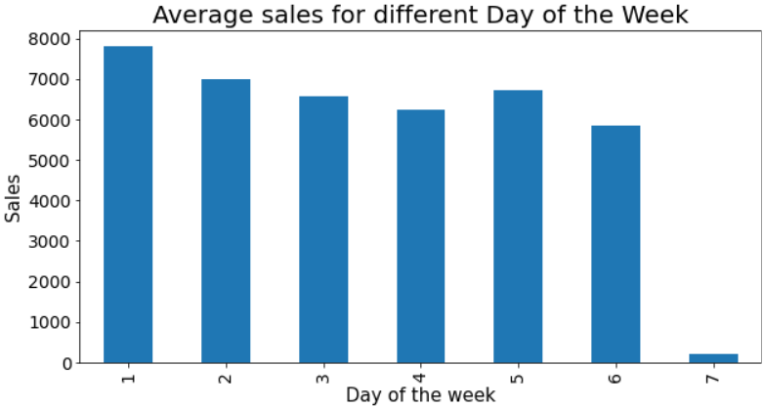
Relationship between average sales and different days of week-
Observation- Average sales is decreasing as the days are passing by, maximum number of sales on Monday and least on Sunday. We can see a sudden spike on Thursday this may be due to reason that the weekend is going to start.

Slide 12
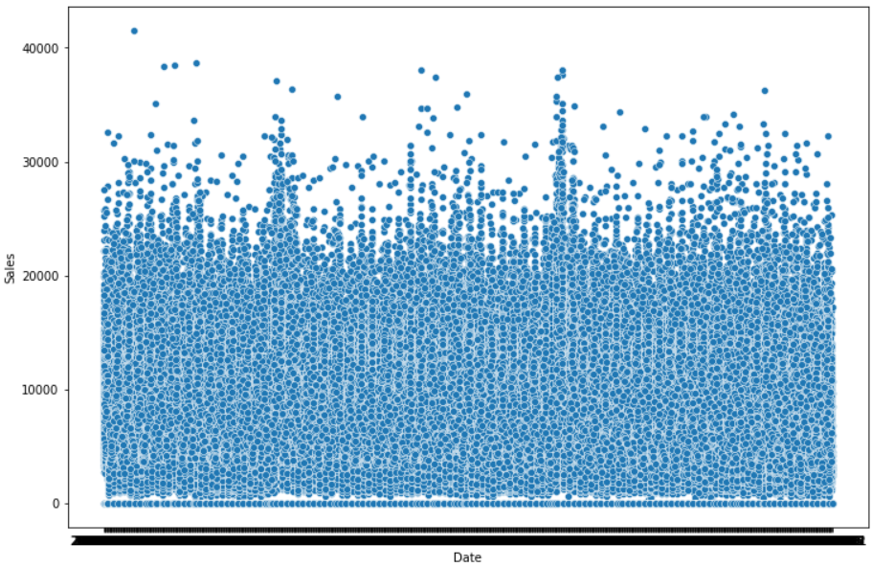
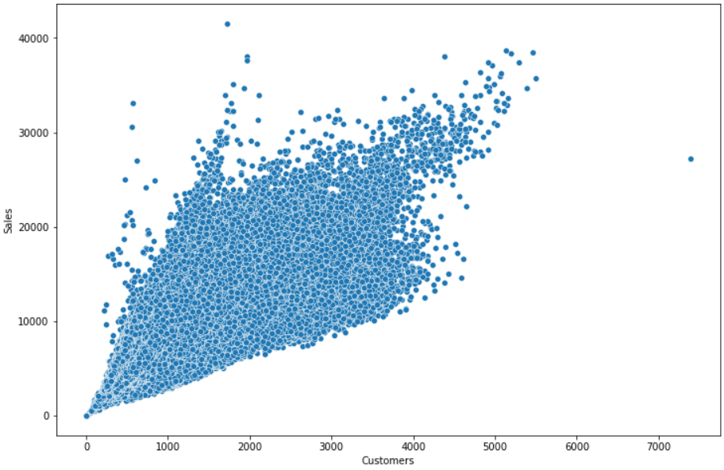
Relationship between date and sales-
Relationship between date and customers-
Observation- There is significantly less corelation between date and sales, all the data is clustered in one place with some outliers.
As per the graphical representation as the customers are increasing there is also increase in sales.

Slide 13
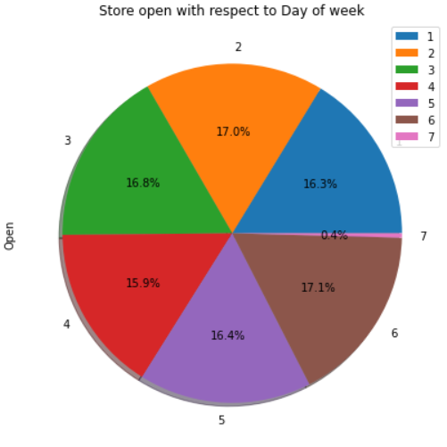
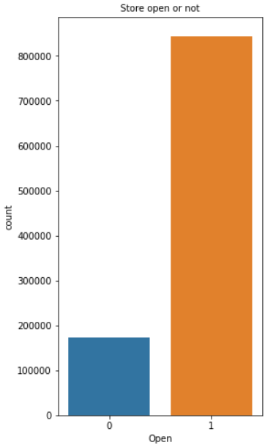
Percentage of stores open on a particular day-
Open and close count-
Observation- Maximum number of stores are open on Saturday and least are open on Sunday.
Store open count is more than store closed count.

Slide 14
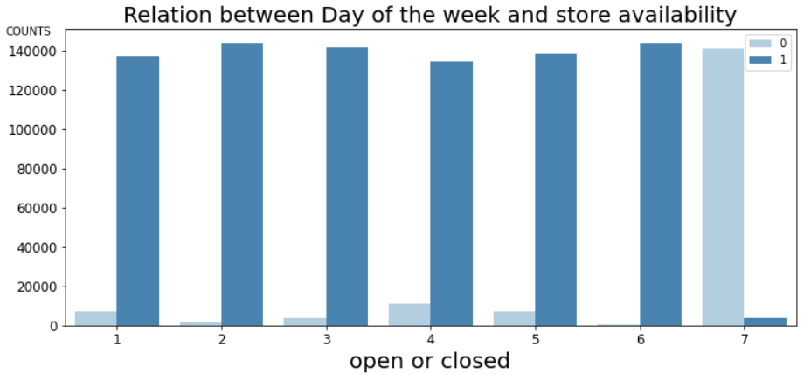
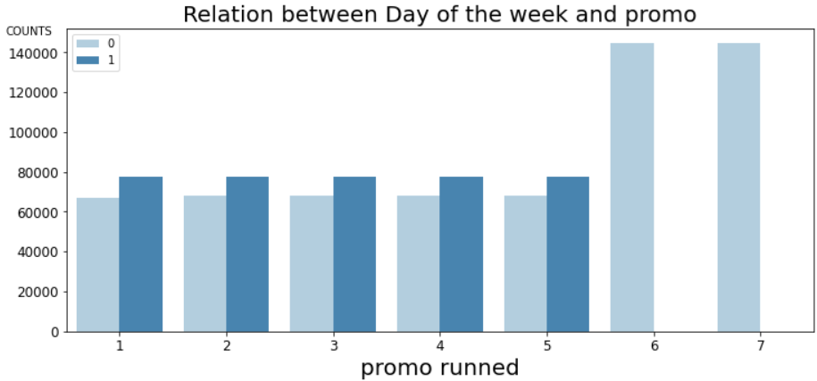
Observation- The store availability is least on Sunday and maximum on Saturday.
From Monday to Friday equal number of promo ran and on weekends there were no promos used.

Slide 15
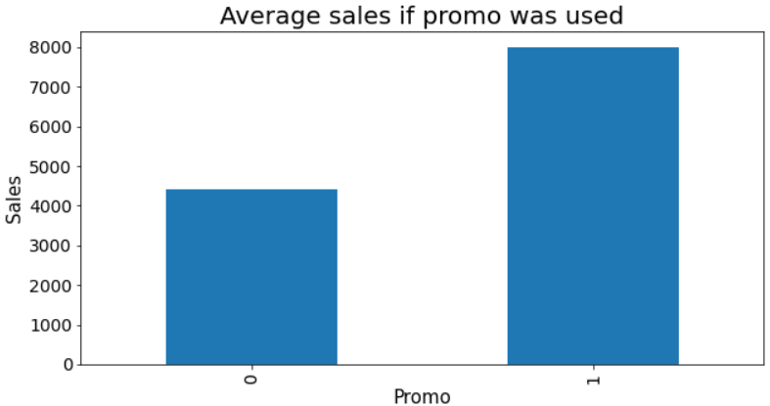
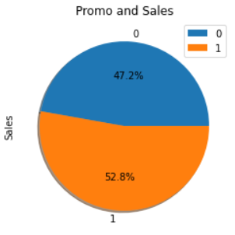
Relationship between sales and promo-
Observation- There was total increase of 5.6% in total sales when the promo ran.

Slide 16
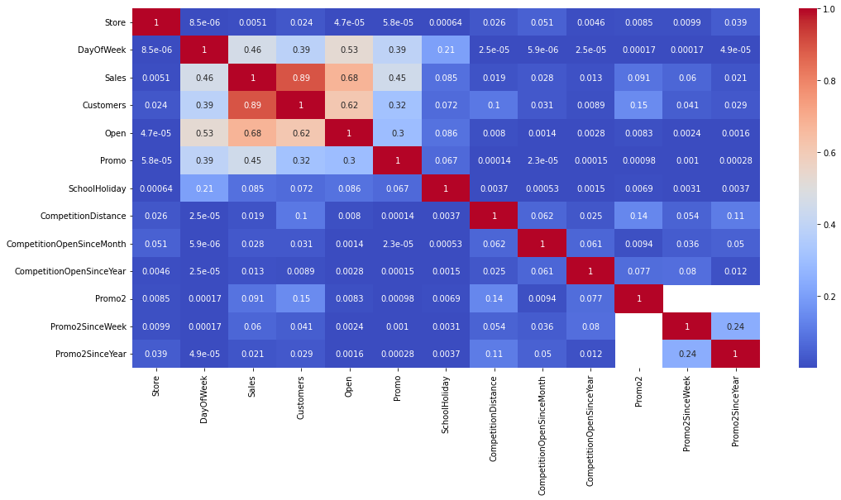
Relation between sales and customers

Slide 17
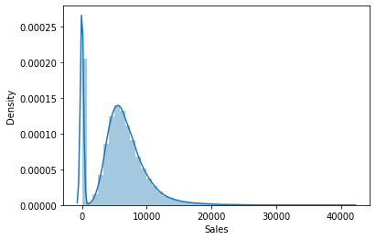
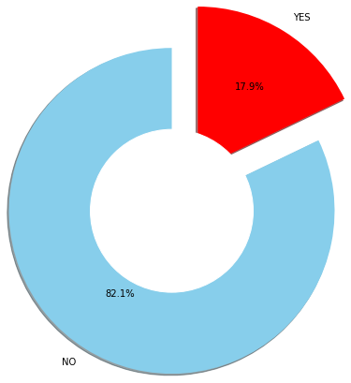
Sales density-
Effect of School holiday on stores-
Observation- Sales a right skewed distribution, this means that the mean is greater than the median.
17.9% of stores are affected by the school holiday

Slide 18
Data cleaning-
At first we extracted year, month and day from “Date” column, then we dropped it.
In the next step we converted all the columns of object type to integer by allotting their categories with numbers.
We checked and found there were multiple null values in 6 different columns. We have filled the “CompetitionDistance” column with 0 considering there are no other competing stores in their area. We have filled “CompetitionOpenSinceMonth” column and “CompetitionOpenSinceYear” column with their mean. Considering that there were no Promo2 so the other related columns like “Promo2SinceWeek”, “Promo2SinceYear” and “PromoInterval” are null, so we filled them with 0.

Slide 19
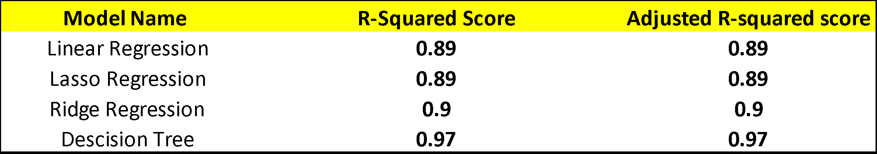
Implementation of regression model-

Slide 20
Conclusion-
Decision tree should be used in the analysis as it outperforms other models and has a r-squared score of 0.97.
Store type B has the maximum number of average sales.
Maximum number of stores are closed on Sunday. So there is increase in average sales on Monday.
Assortment type B has the maximum number of average sales.
17.9% of data suggest that closure of public-school affect the sales.
Average competition distance is 5.4.
Sales in 2013, 2014 and 2015 are stagnant, there is a hardly increase in sales.
As the competition distance increase the sales decrease. This shows that customers are churning to Rossmann Stores, so we should open more store where competition is available.
Store type B should be increased and assortment B should be added to it.
When there is closure of public school more promotion should be done to increase the sales.
Stores should be open on Sundays as there is demands on Sundays also, some people might have gone to the competition stores for the products.
If there was use of promo the sales increased, use of promo should be in increased in the stores specially during holidays.

